Slide 1


Car Price Prediction Analysis
-P. Abirami Soundharya
Data Analytics Sep 2025 Batch

Slide 2

AGENDA
Data Description
DAX Functions
Dashboard Overview
Insights And Recommendations
Conclusion

Slide 3
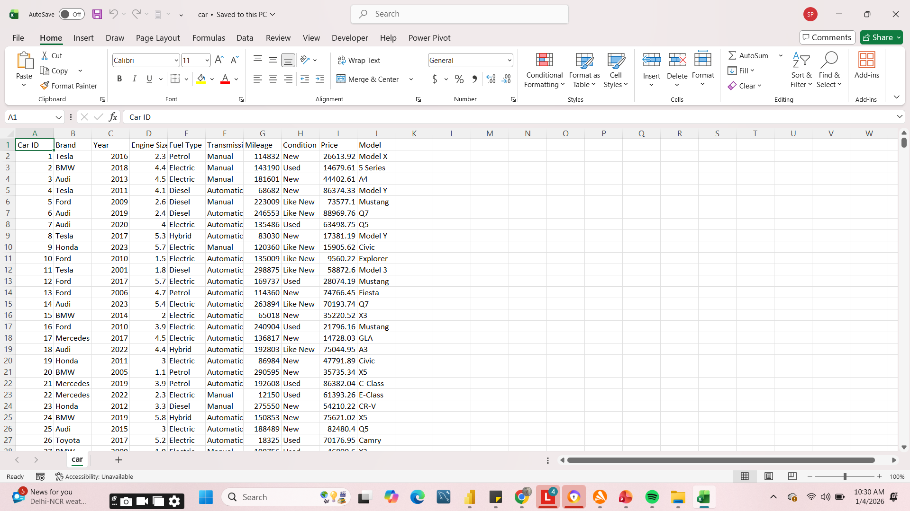
DATA DESCRIPTION
This dataset is designed to provide valuable insights into factors influencing car prices
This dataset contains Car ID, Brand, Year, Engine Size, Fuel Type, Transmission, Mileage, Condition, Price and Model.
DATASET OVERVIEW- 2500 ROWS, 10 COLUMNS.
https://www.kaggle.com/datasets/zafarali27/car-price-prediction/data

Slide 4

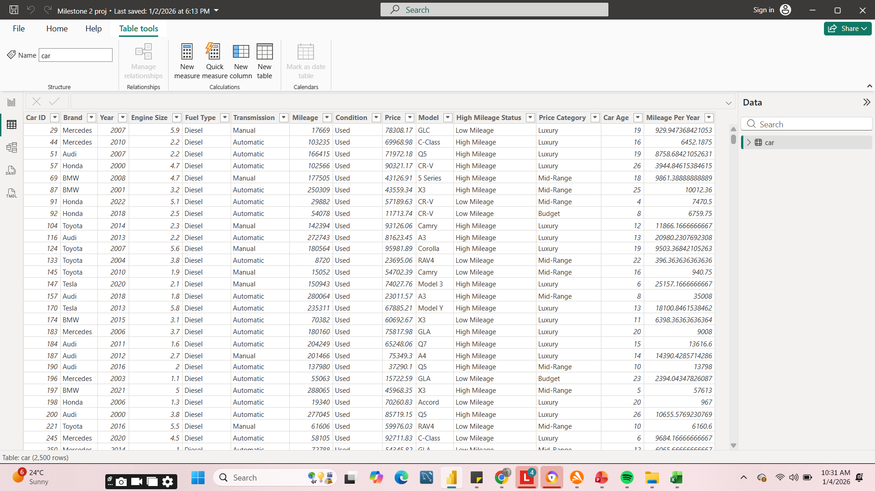
DATA CLEANING
Cleaning process of this dataset includes,
• Dataset checked for respective datatypes
• Duplicates are removed using Remove Duplicate option
Finally clean and clear dataset ready for analysis.

Slide 5
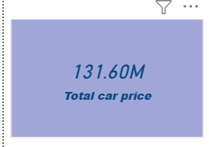
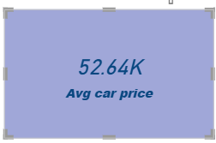

DAX Functions
To get the entire cost of the car, this dax function was developed using
Sum.
The dax function was developed using average to determine the average
cost of a car.
Using DISTINCTCOUNT, this dax function determines the count.

Slide 6

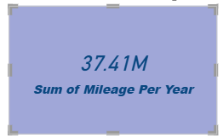
DAX Functions
Using CALCULATE,
this dax function determines the count.
Calculates the age of the vehicle by subtracting the manufacturing year from the current year. Divides the total mileage by the age to find the yearly average.

Slide 7
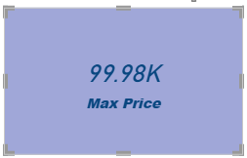
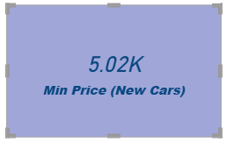
DAX Functions
This dax function is used to calculate the maximum car
price using the max function.
Using the min function, this dax function determines the minimum cost of a new car.

Slide 8
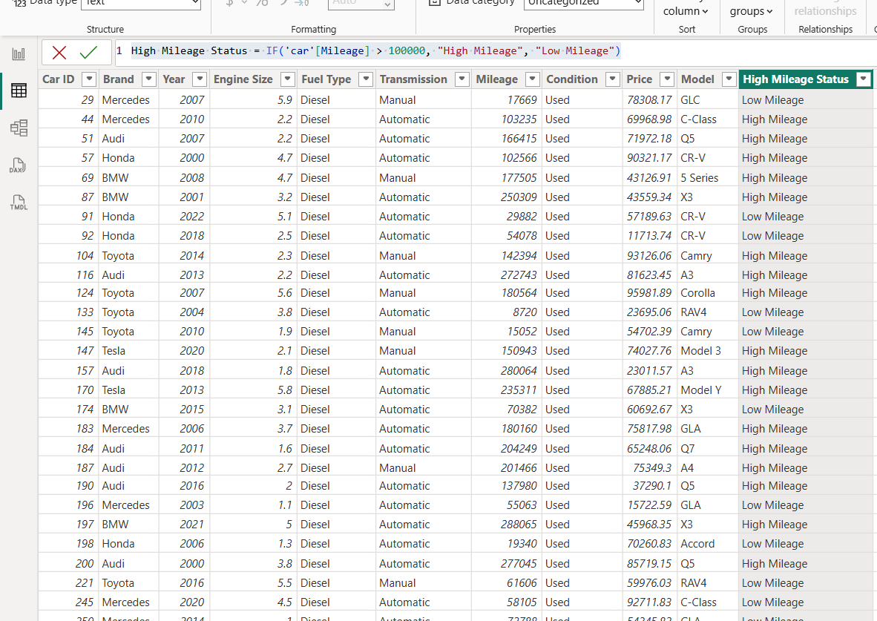
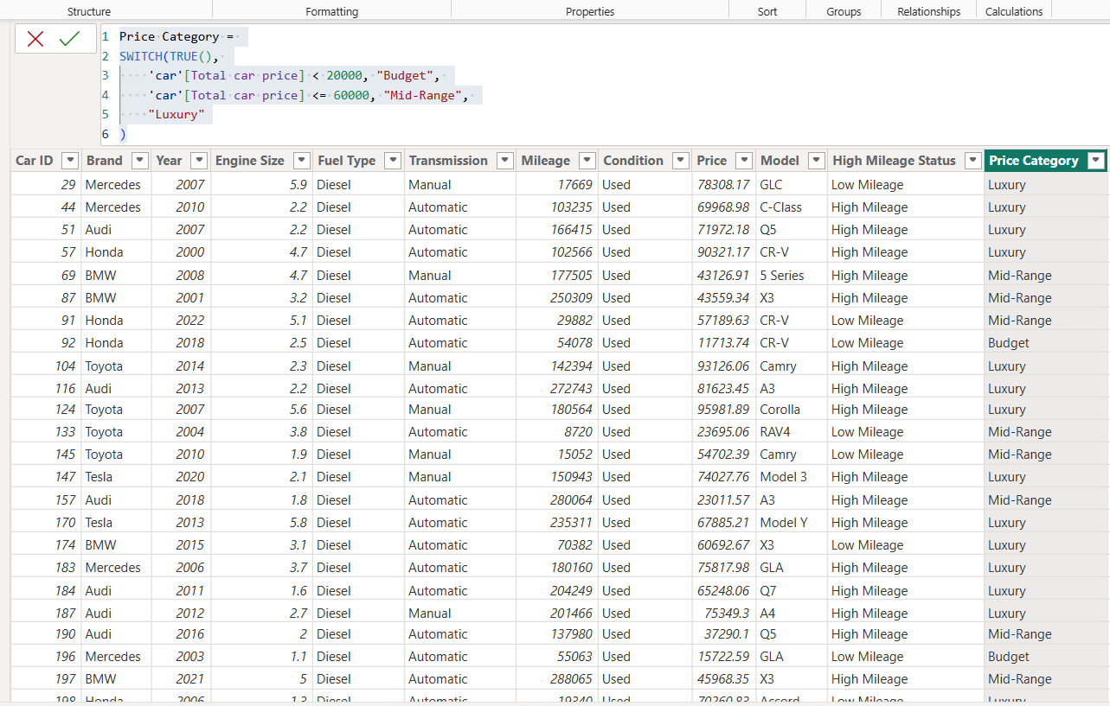
DAX Functions
Using the formula IF('car'[Mileage] > 100000, "High Mileage", "Low Mileage") and an additional column, this dax function determines the High Mileage Status.
Price Category = SWITCH(TRUE(), 'car'[Total car price] < 20000, "Budget", 'car'[Total car price] <= 60000, "Mid-Range", "Luxury") and an additional column are determined using this dax function.

Slide 9
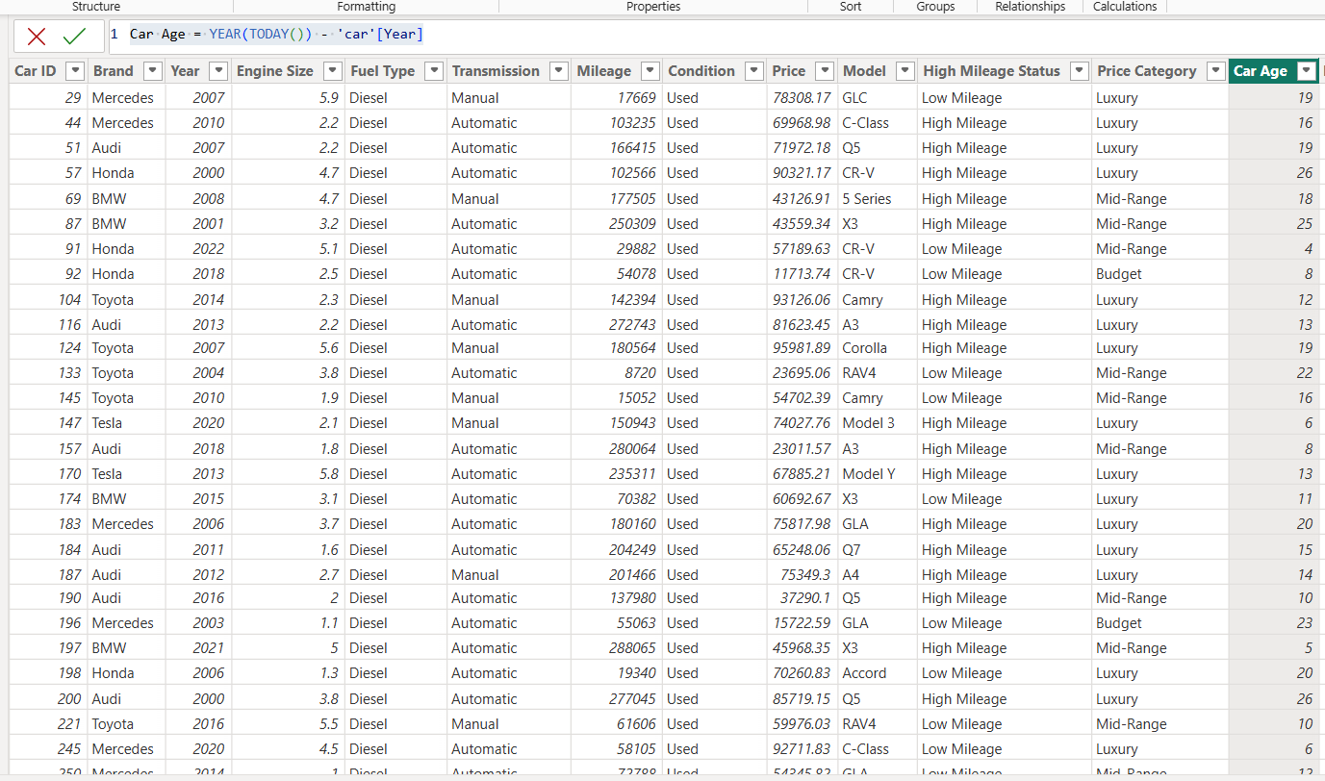
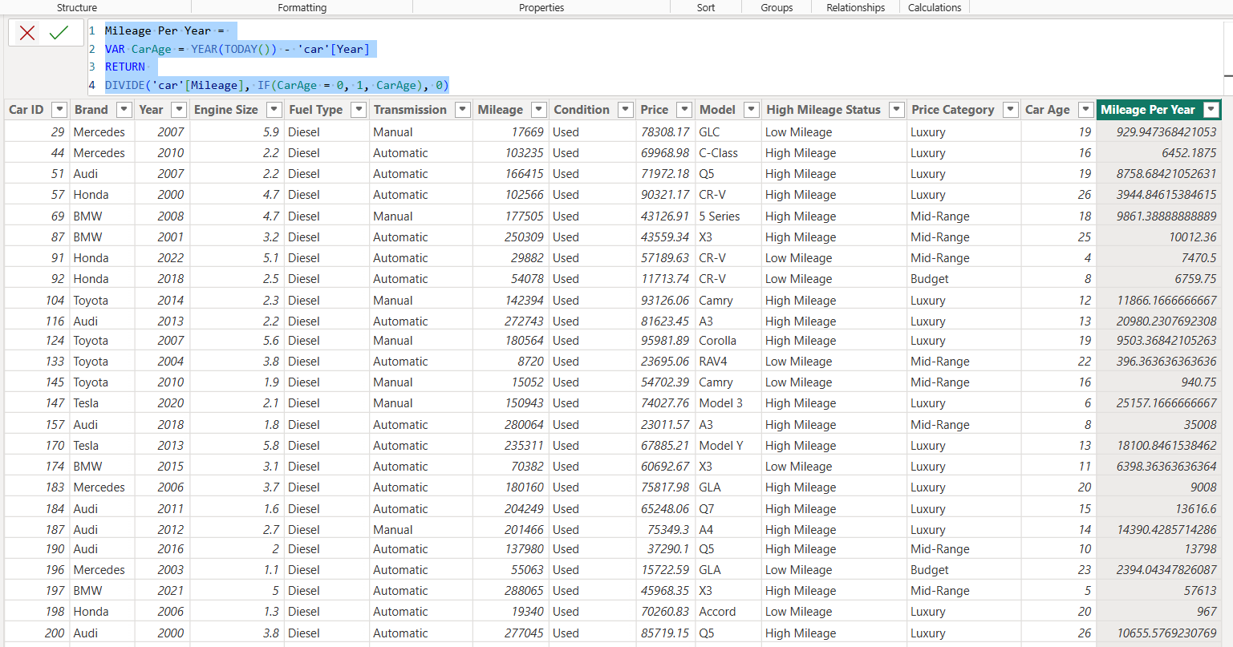
DAX Functions
Car Age = YEAR(TODAY()) - 'car'[Year] and additional column are computed using this dax function.
Mileage Per Year = VAR CarAge = YEAR(TODAY()) - 'car'[Year] is computed using this dax function.
Return the additional column and divide ('car'[Mileage], IF(CarAge = 0, 1, CarAge), 0).

Slide 10
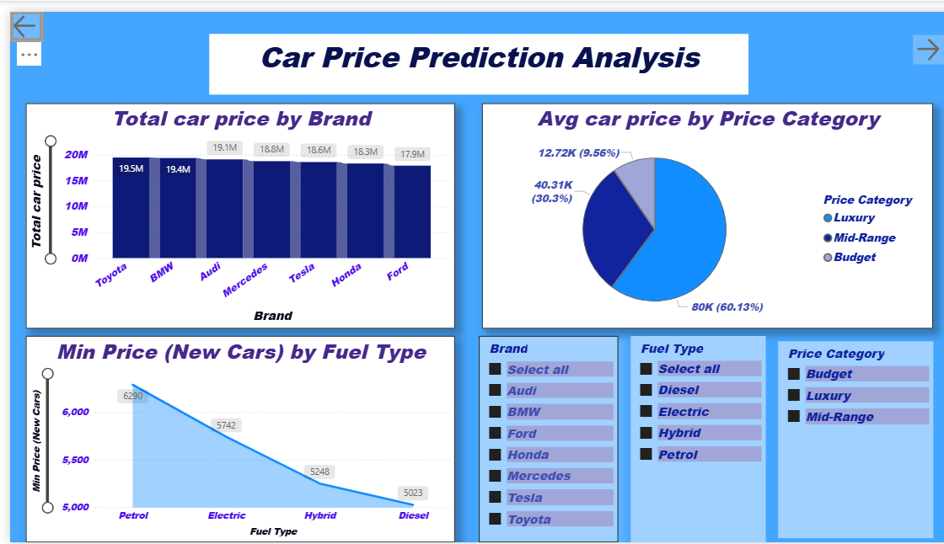
DASHBOARD OVERVIEW

Slide 11
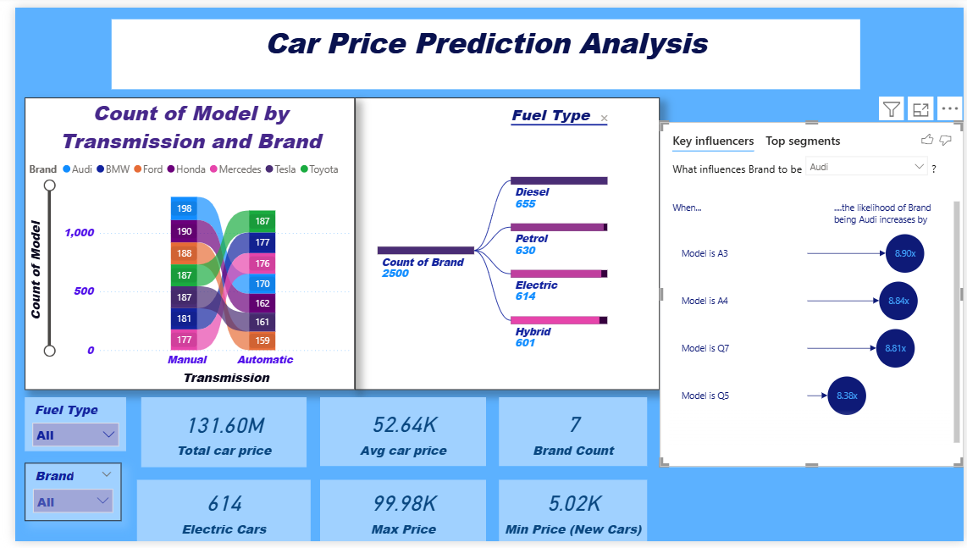
DASHBOARD OVERVIEW

Slide 12
INSIGHTS AND RECOMMENDATIONS
Key Observations: Identify significant trends, such as high-performing sales months or dominant health indicators in specific regions.
Recommendations:
For Sales: Suggest focusing marketing efforts on high-performing product categories.
For Health: Recommend targeted medical screenings for demographic groups showing high risk.
For General Businesses: Propose streamlining operations based on identified bottlenecks

Slide 13
Conclusion
This Power BI solution does more than just display numbers; it provides a framework for predictive decision-making. By leveraging DAX to uncover hidden usage patterns, businesses can optimize their inventory turnover, maximize profit margins, and provide greater transparency to the end consumer.

Slide 14


